Slide 1
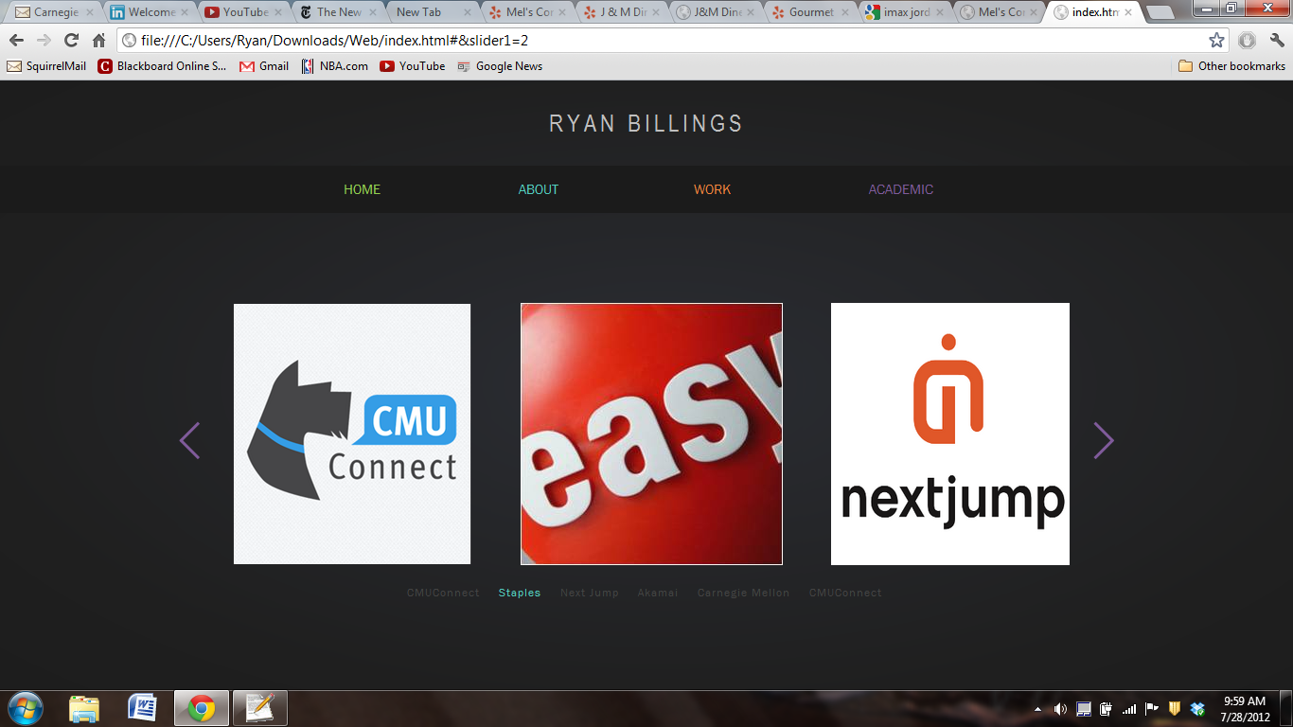

Slide 2
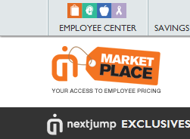
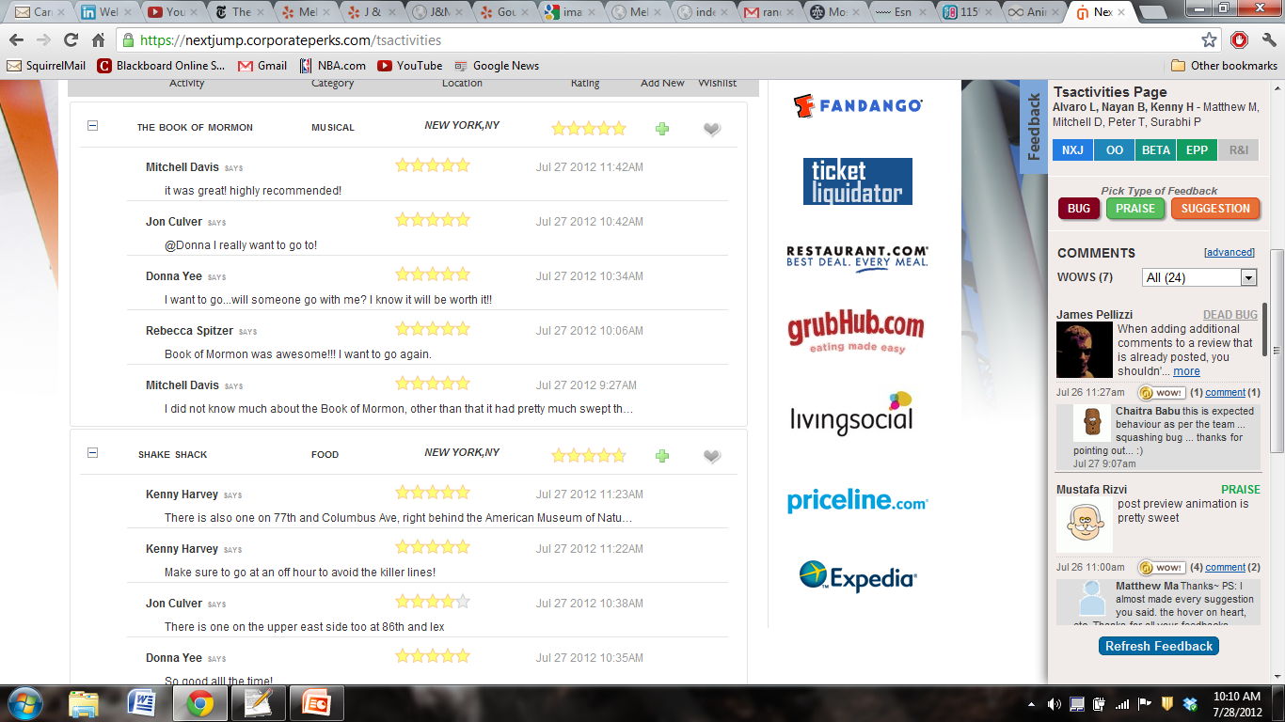
WEB APP DEVELOPMENT
WEB APP DEVELOPMENT
For this project, I… For this project, I For this project, I For this project, I For this project, I For this project, I For this project, I For this project, I For this project, I For this project, I For this project, I For this project, I For this project, I For this project, I For this project, I For this project, I For this project, I For this project, I For this project, I For this project, I
> VIEW A CASE STUDY
V VIEW A CASE STUDY
For this project, I… For this project, I For this project, I For this project, I For this project, I For this project, I For this project, I For this project, I For this project, I For this project, I For this project, I For this project, I For this project, I For this project, I For this project, I For this project, I For this project, I For this project, I For this project, I For this project, I

